Slide 1
Chapter 18: Confinement Problem
What is the problem?
Isolation: virtual machines, sandboxes
Detecting covert channels
Analyzing covert channels
Mitigating covert channels

Slide 2
Overview
The confinement problem
Isolating entities
  Virtual machines
  Sandboxes
Covert channels
  Detecting them
  Analyzing them
  Mitigating them

Slide 3
Example Problem
Server balances bank accounts for clients
Server security issues:
  Record correctly who used it
  Send only balancing info to client
Client security issues:
  Log use correctly
  Do not save or retransmit data client sends

Slide 4
Generalization
Client sends request, data to server
Server performs some function on data
Server returns result to client
Access controls:
  Server must ensure the resources it accesses on behalf of client include only resources client is authorized to access
  Server must ensure it does not reveal client’s data to any entity not authorized to see the client’s data

Slide 5
Confinement Problem
Problem of preventing a server from leaking information that the user of the service considers confidential

Slide 6
Total Isolation
Process cannot communicate with any other process
Process cannot be observed
Impossible for this process to leak information
  Not practical as process uses observable resources such as CPU, secondary storage, networks, etc.

Slide 7
Example
Processes p, q not allowed to communicate
  But they share a file system!
Communications protocol:
  p sends a bit by creating a file called 0 or 1, then a second file called send
    p waits until send is deleted before repeating to send another bit
  q waits until file send exists, then looks for file 0 or 1; whichever exists is the bit
    q then deletes 0, 1, and send and waits until send is recreated before repeating to read another bit

Slide 8
Covert Channel
A path of communication not designed to be used for communication
In example, file system is a (storage) covert channel

Slide 9
Rule of Transitive Confinement
If p is confined to prevent leaking, and it invokes q, then q must be similarly confined to prevent leaking
Rule: if a confined process invokes a second process, the second process must be as confined as the first

Slide 10
Lipner’s Notes
All processes can obtain rough idea of time
  Read system clock or wall clock time
  Determine number of instructions executed
All processes can manipulate time
  Wait some interval of wall clock time
  Execute a set number of instructions, then block

Slide 11
Kocher’s Attack
This computes x = a^{z} mod n, where z = z₀ … z_{k–1}
x := 1; atmp := a;
for i := 0 to k–1 do begin
if z_{i} = 1 then
x := (x * atmp) mod n;
atmp := (atmp * atmp) mod n;
end
result := x;
Length of run time related to number of 1 bits in z

Slide 12
Isolation
Virtual machines
  Emulate computer
  Process cannot access underlying computer system, anything not part of that computer system
Sandboxing
  Does not emulate computer
  Alters interface between computer, process

Slide 13
Virtual Machine (VM)
A program that simulates hardware of computer system
Virtual machine monitor (VMM) provides VM on which conventional OS can run
  Each VM is one subject; VMM knows nothing about processes running on each VM
  VMM mediates all interactions of VM with resources, other VMS
  Satisfies rule of transitive closure

Slide 14
Example: KVM/370
Security-enhanced version of IBM VM/370 VMM
Goals
  Provide virtual machines for users
  Prevent VMs of different security classes from communicating
Provides minidisks; some VMs could share some areas of disk
  Security policy controlled access to shared areas to limit communications to those allowed by policy

Slide 15
DEC VAX VMM
VMM is security kernel
  Can run Ultrix OS or VMS OS
Invoked on trap to execute privileged instruction
  Only VMM can access hardware directly
  VM kernel, executive levels both mapped into physical executive level
VMM subjects: users, VMs
  Each VM has own disk areas, file systems
  Each subject, object has multilevel security, integrity labels

Slide 16
Sandbox
Environment in which actions of process are restricted according to security policy
  Can add extra security-checking mechanisms to libraries, kernel
    Program to be executed is not altered
  Can modify program or process to be executed
    Similar to debuggers, profilers that add breakpoints
    Add code to do extra checks (memory access, etc.) as program runs (software fault isolation)

Slide 17
Example: Limiting Execution
Sidewinder
  Uses type enforcement to confine processes
  Sandbox built into kernel; site cannot alter it
Java VM
  Restricts set of files that applet can access and hosts to which applet can connect
DTE, type enforcement mechanism for DTEL
  Kernel modifications enable system administrators to configure sandboxes

Slide 18
Example: Trapping System Calls
Janus: execution environment
  Users restrict objects, modes of access
Two components
  Framework does run-time checking
  Modules determine which accesses allowed
Configuration file controls modules loaded, constraints to be enforced

Slide 19
Janus Configuration File
# basic module
basic
  — Load basic module
# define subprocess environment variables
putenv IFS=”\t\n “ PATH=/sbin:/bin:/usr/bin TZ=PST8PDT
  — Define environmental variables for process
# deny access to everything except files under /usr
path deny read,write *
path allow read,write /usr/*
  — Deny all file accesses except to those under /usr
# allow subprocess to read files in library directories
# needed for dynamic loading
path allow read /lib/* /usr/lib/* /usr/local/lib/*
  — Allow reading of files in these directories (all dynamic load libraries are here)
# needed so child can execute programs
path allow read,exec /sbin/* /bin/* /usr/bin/*
  — Allow reading, execution of subprograms in these directories

Slide 20
Janus Implementation
System calls to be monitored defined in modules
On system call, Janus framework invoked
  Validates system call with those specific parameters are allowed
  If not, sets process environment to indicate call failed
  If okay, framework gives control back to process; on return, framework invoked to update state
Example: reading MIME mail
  Embed “delete file” in Postscript attachment
  Set Janus to disallow Postscript engine access to files

Slide 21
Covert Channels
Channel using shared resources as a communication path
Covert storage channel uses attribute of shared resource
Covert timing channel uses temporal or ordering relationship among accesses to shared resource

Slide 22
Example: File Manipulation
Communications protocol:
  p sends a bit by creating a file called 0 or 1, then a second file called send
    p waits until send is deleted before repeating to send another bit
  q waits until file send exists, then looks for file 0 or 1; whichever exists is the bit
    q then deletes 0, 1, and send and waits until send is recreated before repeating to read another bit
Covert storage channel: resource is directory, names of files in directory

Slide 23
Example: Real-Time Clock
KVM/370 had covert timing channel
  VM1 wants to send 1 bit to VM2
  To send 0 bit: VM1 relinquishes CPU as soon as it gets CPU
  To send 1 bit: VM1 uses CPU for full quantum
  VM2 determines which bit is sent by seeing how quickly it gets CPU
  Shared resource is CPU, timing because real-time clock used to measure intervaps between accesses

Slide 24
Example: Ordering of Events
Two VMs
  Share cylinders 100–200 on a disk
  One is High, one is Low; process on High VM wants to send to process on Low VM
Disk scheduler uses SCAN algorithm
Low process seeks to cylinder 150 and relinquishes CPU
  Now we know where the disk head is

Slide 25
Example (con’t)
High wants to send a bit
  To send 1 bit, High seeks to cylinder 140 and relinquish CPU
  To send 0 bit, High seeks to cylinder 160 and relinquish CPU
Low issues requests for tracks 139 and 161
  Seek to 139 first indicates a 1 bit
  Seek to 161 first indicates a 0 bit
Covert timing channel: uses ordering relationship among accesses to transmit information

Slide 26
Noise
Noiseless covert channel uses shared resource available to sender, receiver only
Noisy covert channel uses shared resource available to sender, receive, and others
  Need to minimize interference enough so that message can be read in spite of others’ use of channel

Slide 27
Key Properties
Existence
  Determining whether the covert channel exists
Bandwidth
  Determining how much information can be sent over the channel

Slide 28
Detection
Covert channels require sharing
Manner of sharing controls which subjects can send, which subjects can receive information using that shared resource
Porras, Kemmerer: model flow of information through shared resources with a tree
  Called covert flow trees

Slide 29
Goal Symbol Tree Nodes
Modification: attribute modified
Recognition: attribute modification detected
Direct recognition: subject can detect attribute modification by referencing attribute directly or calling function that returns it
Inferred recognition: subject can detect attribute modification without direct reference
Inferred-via: info passed from one attribute to another via specified primitive (e.g. syscall)
Recognized-new-state: modified attribute specified by inferred-via goal

Slide 30
Other Tree Nodes
Operation symbol represents primitive operation
Failure symbol indicates information cannot be sent along path
And symbol reached when for all children
  Child is operation; and
  If child goal, then goal is reached
Or symbol reached when for any child:
  Child is operation; or
  If child goal, then goal is reached

Slide 31
Constructing Tree
Example: files in file system have 3 attributes
  locked: true when file locked
  isopen: true when file opened
  inuse: set containing PID of processes having file open
Functions:
  read_access(p, f): true if p has read rights over file f
  empty(s): true if set s is empty
  random: returns one of its arguments chosen at random

Slide 32
Locking and Opening Routines
(* lock the file if it is not locked and not opened; otherwise indicate it is locked by returning false *)
procedure Lockfile(f: file): boolean;
begin
if not f.locked and empty(f.inuse) then
f.locked := true;
end;
(* unlock the file *)
procedure Unlockfile(f: file);
begin
if f.locked then
f.locked := false;
end;
(* say whether the file is locked *)
function Filelocked(f: file): boolean;
begin
Filelocked := f.locked;
end;
(* open the file if it isn’t locked and the process has the right to read the file *)
procedure Openfile(f: file);
begin
if not f.locked and read_access(process_id, f) then
(* add process ID to inuse set *)
f.inuse = f.inuse + process_id;
end;
(* if the process can read the file, say if the file is open, otherwise return a value at random *)
function Fileopened(f: file): boolean;
begin
if not read_access(process_id, f) then
Fileopened := random(true, false);
else
Fileopened := not isempty(f.inuse);
end

Slide 33
Attributes and Operations
 | Lockfile | Unlockfile | Filelocked | Openfile | Fileopened
reference | locked, inuse | locked | locked | locked, inuse | inuse
modify | locked | ∅ | ∅ | inuse | ∅
return | ∅ | ∅ | locked | ∅ | inuse
∅ means no attribute affected in specified manner

Slide 34
Tree Construction
This is for attribute locked
  Goal state: “covert storage channel via attribute locked”
  Type of goal controls construction
“And” node has 2 children, a “modification” and a “recognition”
  Here, both “of attribute locked”

Slide 35
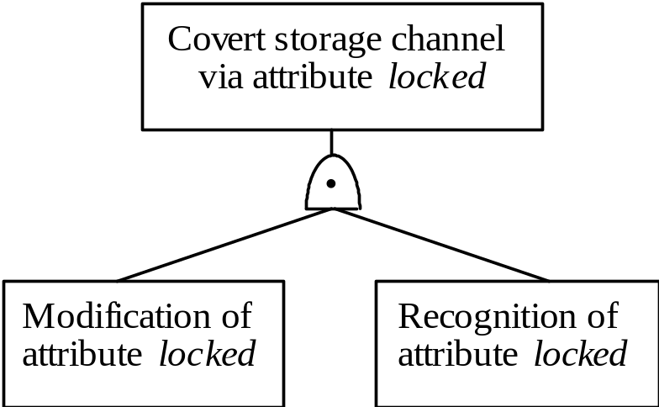
First Step
Put “and” node under goal
Put children under “and” node

Slide 36
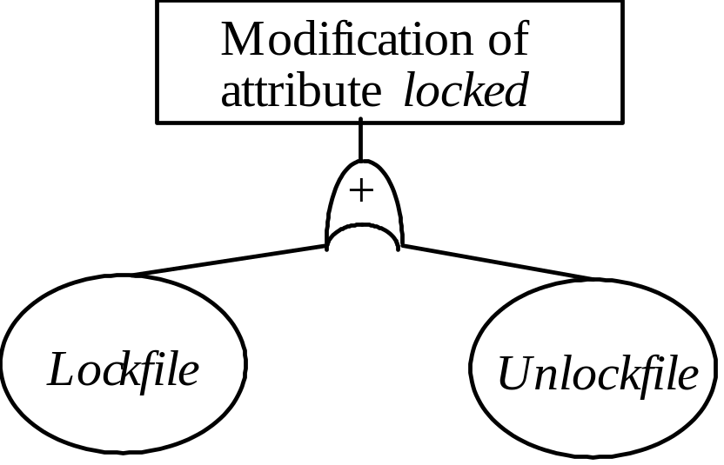
Second Step
Operations Lockfile and Unlockfile modify locked
  See attribute and operations table

Slide 37
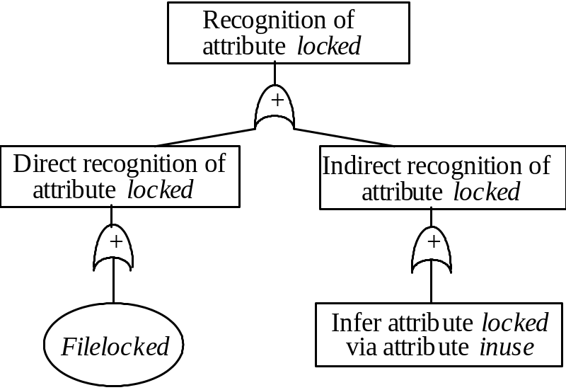
Third Step
“Recognition” had direct, inferred recognition children
Direct recognition child: “and” node with Filelocked child
  Filelocked returns value of locked
Inferred recognition child: “or” node with “inferred-via” node
  Infers locked from inuse

Slide 38
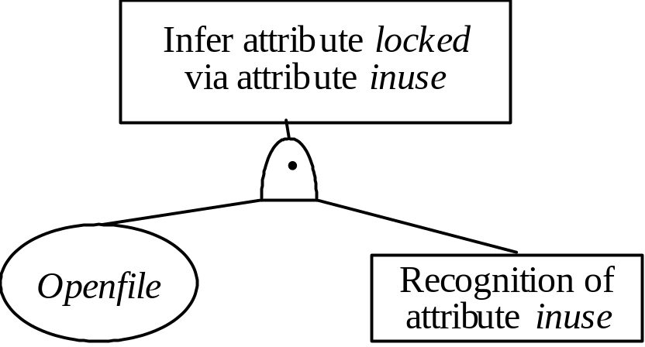
Fourth Step
“Inferred-via” node requires Openfile
  Change in attribute inuse represented by recognize-new-state goal

Slide 39
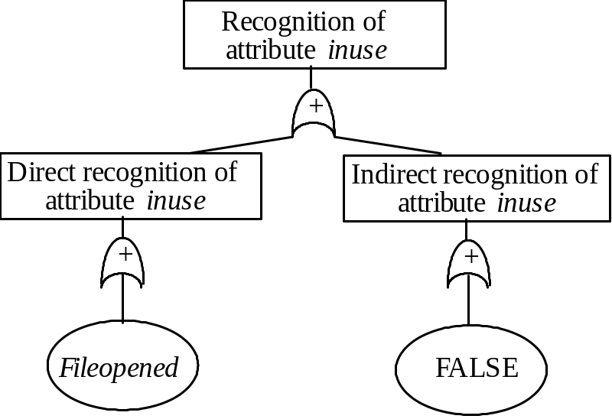
Fifth Step
“Recognize-new-state” node
  Direct recognition node: “or” child, Fileopened node beneath (recognizes change in inuse directly)
  Inferred recognition node: “or” child, FALSE node beneath (nothing recognizes change in inuse indirectly)

Slide 40
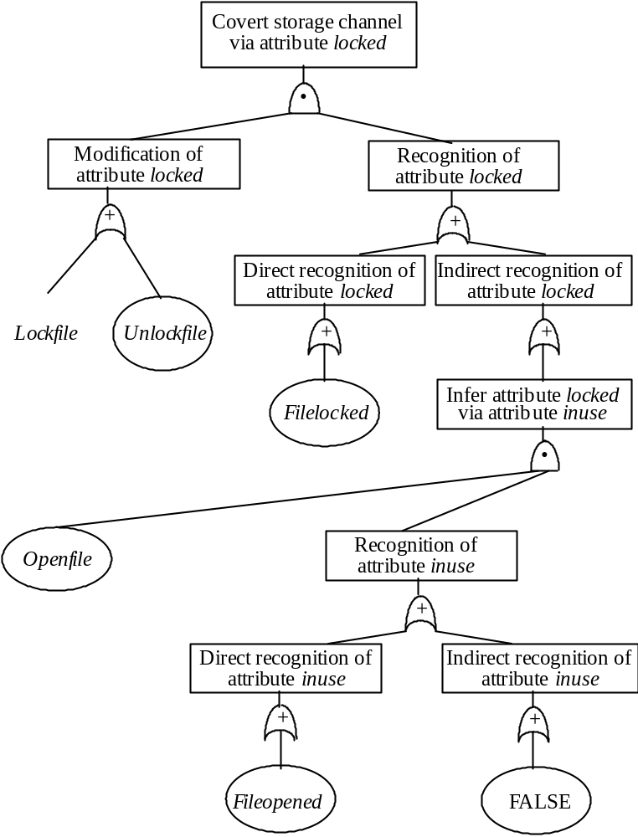
Final Tree

Slide 41
Finding Covert Channels
Find sequences of operations that modify attribute
  ( Lockfile ), ( Unlockfile )
Find sequences of operations that recognize modifications to attribute
  ( Filelocked ), ( Openfile, Fileopened ) )

Slide 42
Covert Channel Commands
Sequences with first element from first list, second element from second list
  Lockfile, then Filelocked
  Unlockfile, then Filelocked
  Lockfile, then Openfile, then Fileopened
  Unlockfile, then Openfile, then Fileopened

Slide 43
Mitigation
Goal: obscure amount of resources a process uses
  Receiver cannot determine what part sender is using and what part is obfuscated
How to do this?
  Devote uniform, fixed amount of resources to each process
  Inject randomness into allocation, use of resources

Slide 44
Example: Pump
communications buffer
holds n items
Low
buffer
High
buffer
Low process
High process

Slide 45
Covert Timing Channel
High process can control rate at which pump sends it messages
Initialization: Low sends messages to pump until communications buffer full
  Low gets ACK for each message put into the buffer; no ACK for messages when communications buffer full
Protocol: sequence of trials; for each trial
  High sends a 1 by reading a message
    Then Low gets ACK when it sends another message
  High sends a 0 by not reading a message
    Then Low doesn’t gets ACK when it sends another message

Slide 46
How to Fix
Assume: Low process, pump can process messages faster than High process
Case 1: High process handles messages more quickly than Low process gets acknowledgements
  Pump artificially delaying ACKs
    Low process waits for ACK regardless of whether buffer is full
  Low cannot tell whether buffer is full
    Closes covert channel
  Not optimal (processes may wait even when unnecessary)

Slide 47
How to Fix (con’t)
Case 2: Low process sends messages faster than High process can remove them
  Maximizes performance
  Opens covert channel
Case 3: Pump, processes handle messages at same rate
  Decreases bandwidth of covert channel, increases performance
  Opens covert channel, sub-optimal performance

Slide 48
Adding Noise to Direct Channel
Kang, Moskowitz: do this in such a way as to approximate case 3
  Reduces covert channel’s capacity to 1/nr
    r time between Low process sending message and receiving ACK when buffer not full
  Conclusion: pump substantially reduces capacity of covert channel between High, Low processes when compared with direct connection

Slide 49
Key Points
Confinement problem: prevent leakage of information
  Solution: separation and/or isolation
Shared resources offer paths along which information can be transferred
Covert channels difficult if not impossible to eliminate
  Bandwidth can be greatly reduced, however!

